Slide 1

Welcome to all
for the Advertising Online lecture
Chapter 3- Economic and Social aspect of adverting
By
Dr. Dhiraj Ovhal
HOD of Commerce

Slide 2
Write Meaning, Definition and Features of Advertising
Meaning:- The word advertising comes from Latin word “Advertere” which means to turn the mind towards .
The primary goal of advertising is to attract attention of audience and induce them to purchase advertising products and services.
Definition:- Definition AMA defines (American Marketing
Association)
“Any paid form of Non personal presentation,
Promotion of ideas, goods and service by an
indentified sponsor.”

Slide 3
Q.4 Ethical issues in Advertising and explain Untruthful forms of advertising?
Meaning:-
The word ethics is derived from Greek word “Ethos” which means “Character’ or “Fundamental Values”.
Ethics is branch of Philosophy which is concerned with ethical values and moral characteristics.
What is good should be followed and what is bad should be discarded or avoided.
Good advertising refers to honest advertising.
Right product with right price
Right information
No cheating or misleading information
Right channel of promotion

Slide 4
Forms of Untruthful Advertising
(WAY to remember ):-
Economic Sachin Mungase | Law Prashant Bhide | A/C Financial
E. S.M² | L.P² .B | A.C.F²

Slide 5
Exaggeration :- (Overstatement)
Surrogate Advertising
Misuse of testimonials E.S.M²
Misrepresentation
Lies (Total Lies)
Pressure tactics
Poor taste L.P² .B
Brand comparison – unhealthy
Advertising to children
Claim for winning awards/certificate A/C F²
False statistics
Free gift, discount, coupon

Slide 6

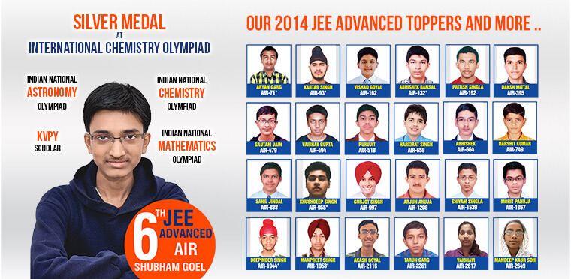
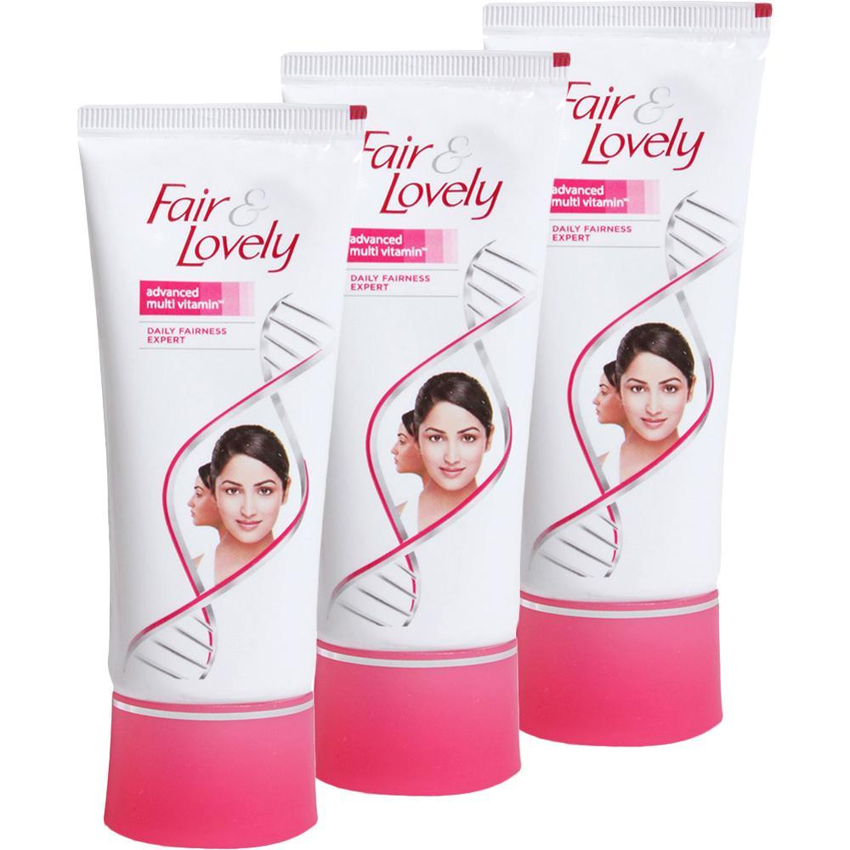
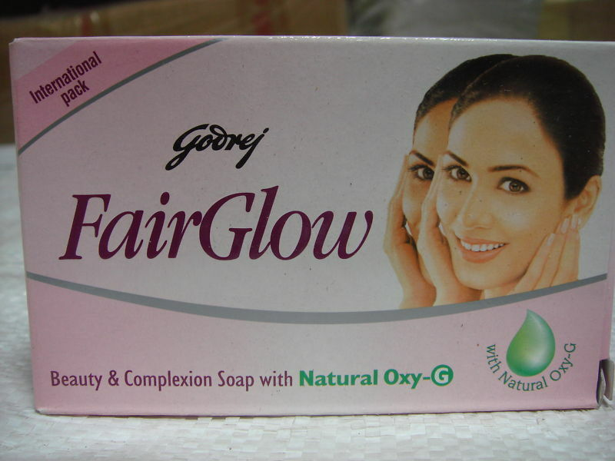
Exaggeration :- (Overstatement)

Slide 7
Exaggeration :- (Overstatement)
Some advertisers make tall claims in their ads about their products. Tall claims are often made in case of detergents and A washing powder, cosmetics and toiletries. For instance, you may have come across such ads of detergent powder claiming that can wash whitest a dozen of clothes with just a teaspoonful! powder. A good example of exaggeration is that of Colgate toothpaste "No germs, no cavities.

Slide 8


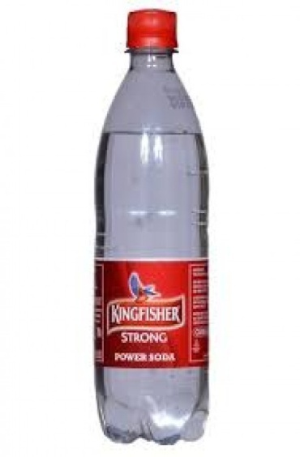
2. Surrogate Advertising

Slide 9
2. Surrogate Advertising
Many times the advertises are not allowed to advertise unhealthy or unsocial products on certain media that time they can take the help of back door entry called as surrogate advertising.

Slide 10

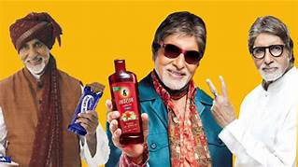
3. Misuse of testimonials :-

Slide 11
3. Misuse of testimonials :-
Testimonial is a statement given by a popular personality or any other person claiming the superiority of the brand. In fact, many! advertisers pay handsome amounts of money to extract the statement from a personality even though he/she may not be the user of the product. Take the example of ads of soaps, cosmetics, foods products, etc. You will come across a personality praising the product so much, but in reality she/he must not have used the such products.

Slide 12
Misrepresentation:-
We must have come across competing brands with similar names,
such as Lux and Lex,
Bata and Bala.
Sintex and Suntex,
Parle-G and Parle C
etc.
Also some sellers may state that their product is of export quality and sometimes they say that their product is made as Japan'. All this is done to fool the customers.

Slide 13
5. Lies (Total Lies)
There are also cases of advertisers presenting total lies in the ads to trick the customers. For instance, one ad sand "You ca reduce your weight "no dieting, no drugs, no exercises, fasting'. And some of those who responded to this ad landed the hospital

Slide 14
6. Pressure tactics
Some firms use pressure tactics to persuade customers to buy the products or services. For instance, certain private institutions may state the last date for enrolment. After some days again they extend the last date and continue to do so to fool the students.

Slide 15
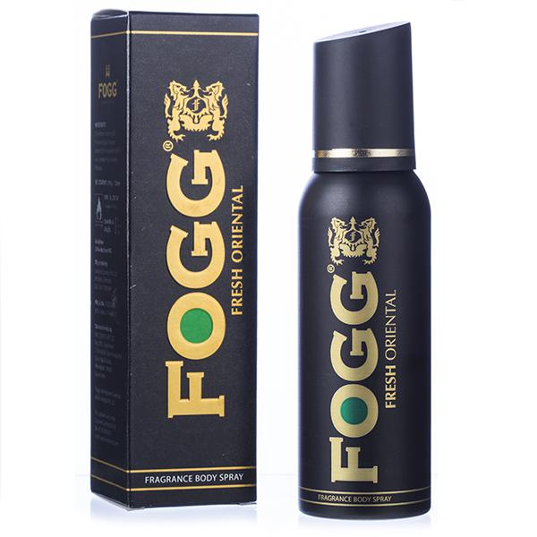
7. Poor taste :-
At times some advertisers present vulgar scenes involving sexual innuendo, nudity and double meaning. For instance,
All ads of Deos or body spray

Slide 16
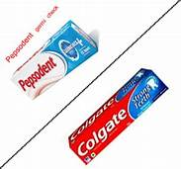
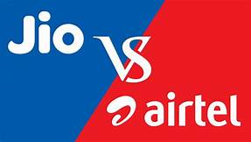
8. Brand comparison – unhealthy
Now-a-days, advertisers are engaged in unhealthy brand comparisons with the help of advertising. Such comparisons create problems and confusion for the right choice of products as far as audience is concerned. Examples can be cited that of Colgate toothpaste, and Pepsodent toothpaste.

Slide 17
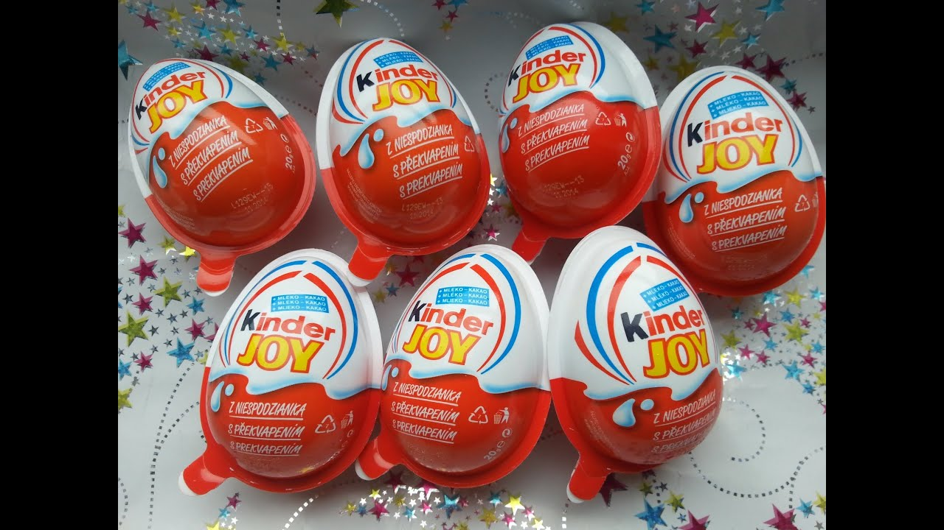
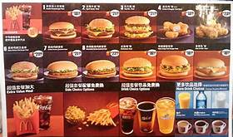
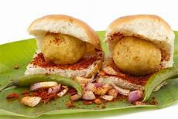
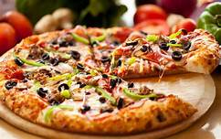
9. Advertising to children:-

Slide 18
9. Advertising to children:-
Advertisers try to exploit the young kids by advertising products which are not conducive to their health. This includes the ads of chocolates, soft-drinks, etc. Quite often such products lack nutritional value. However, they make believe the kids that such products are healthy for their mind and body, and as such the kids demand such products from their parents. There are cases where ads created inferiority complex if they do not use the

Slide 19
10. Claim for winning awards/certificate.:-
Advertisers make claims that they have won international and for their excellence in quality. They may have won such awards but many-a-times, the awards may be consolation ones. Again the quality that they have presented may be far superior than what they sell in the local market.

Slide 20
11. False statistics:-
There are also advertisers who make use of false statistics to substantiate the superiority of their brands. For instance one magazine stated ‘One lakh copies already sold' but hardly few copies may be actually sold. Also, unethical educational institutions - (Indian as well as foreign ones) - state fake statistics such as rankings, placements, etc. to induce students to join their institutions.

Slide 21
12. Free gift, discount, coupon:-
You must have come across such ads as 'Pay for two and take three' or upto 50% discount or enter into a crossword puzzle or some other contest and win handsome prizes. Most of such advertising is another trick to fool the innocent customers. Even if the advertiser gives free gifts, they may not be worth the name and if there is discount sale, the product may be damaged or of old stock or of inferior quality. And there are contests in which the decision of the judges is final in favour of their known contest.

Slide 22
Economic impact of Advertising
Forms of Untruthful Advertising
(WAY to remember ):-
Economic Sachin Mungase | Law Prashant Bhide | A/C Financial
E. S.M² | L.P² .B | A.C.F²

Slide 23
Thank You

Slide 24
Attendance Link
https://forms.gle/U4Da9ykpniL3tpCdA
(Mention date at last point)

